Slide 1
Problem-Needs-Solution
Analysis
Adapted from Nate Murray

Slide 2
Once a group encounters a problem, the questions that come up range from “Where do we start?” to “How do we solve it?”
Define the problem
Analyze the problem
Establish criteria
Consider possible solutions
Decide on a solution
Implement the solution
Follow up on the solution

Slide 3
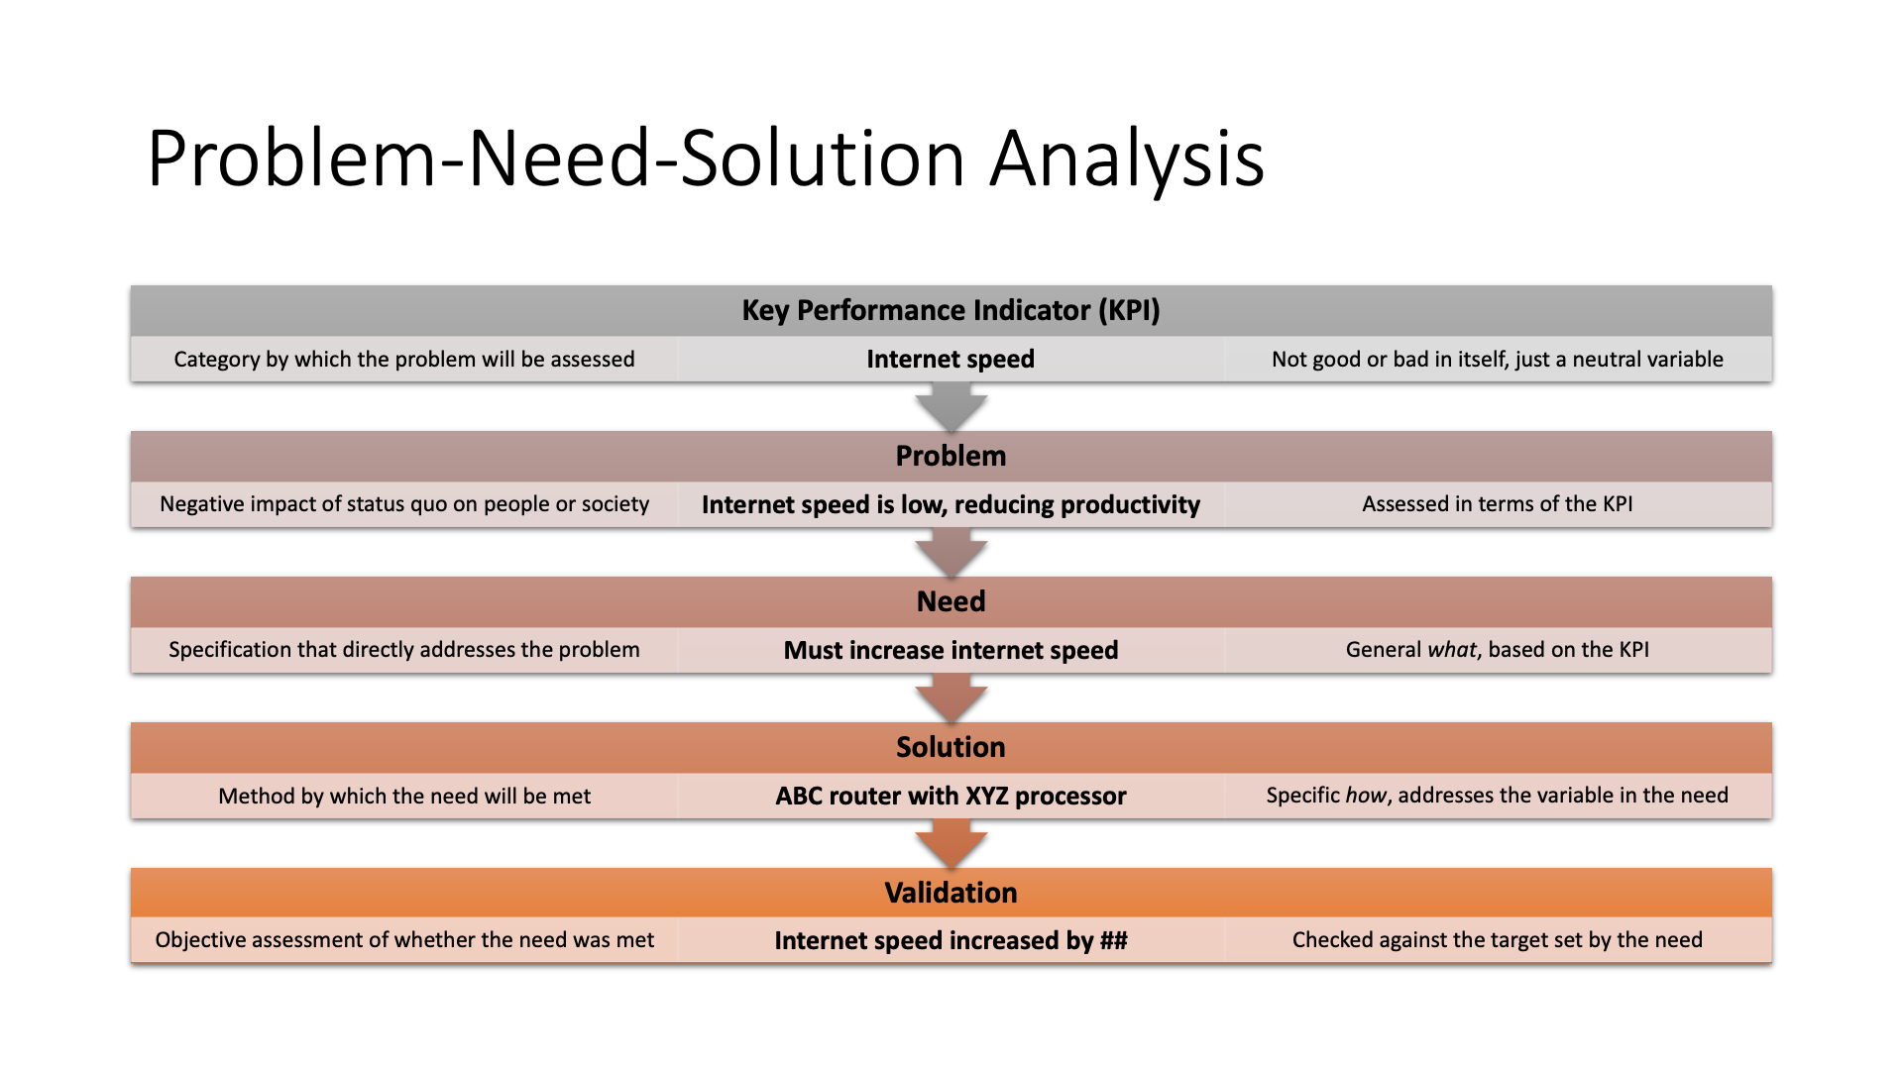

Slide 4
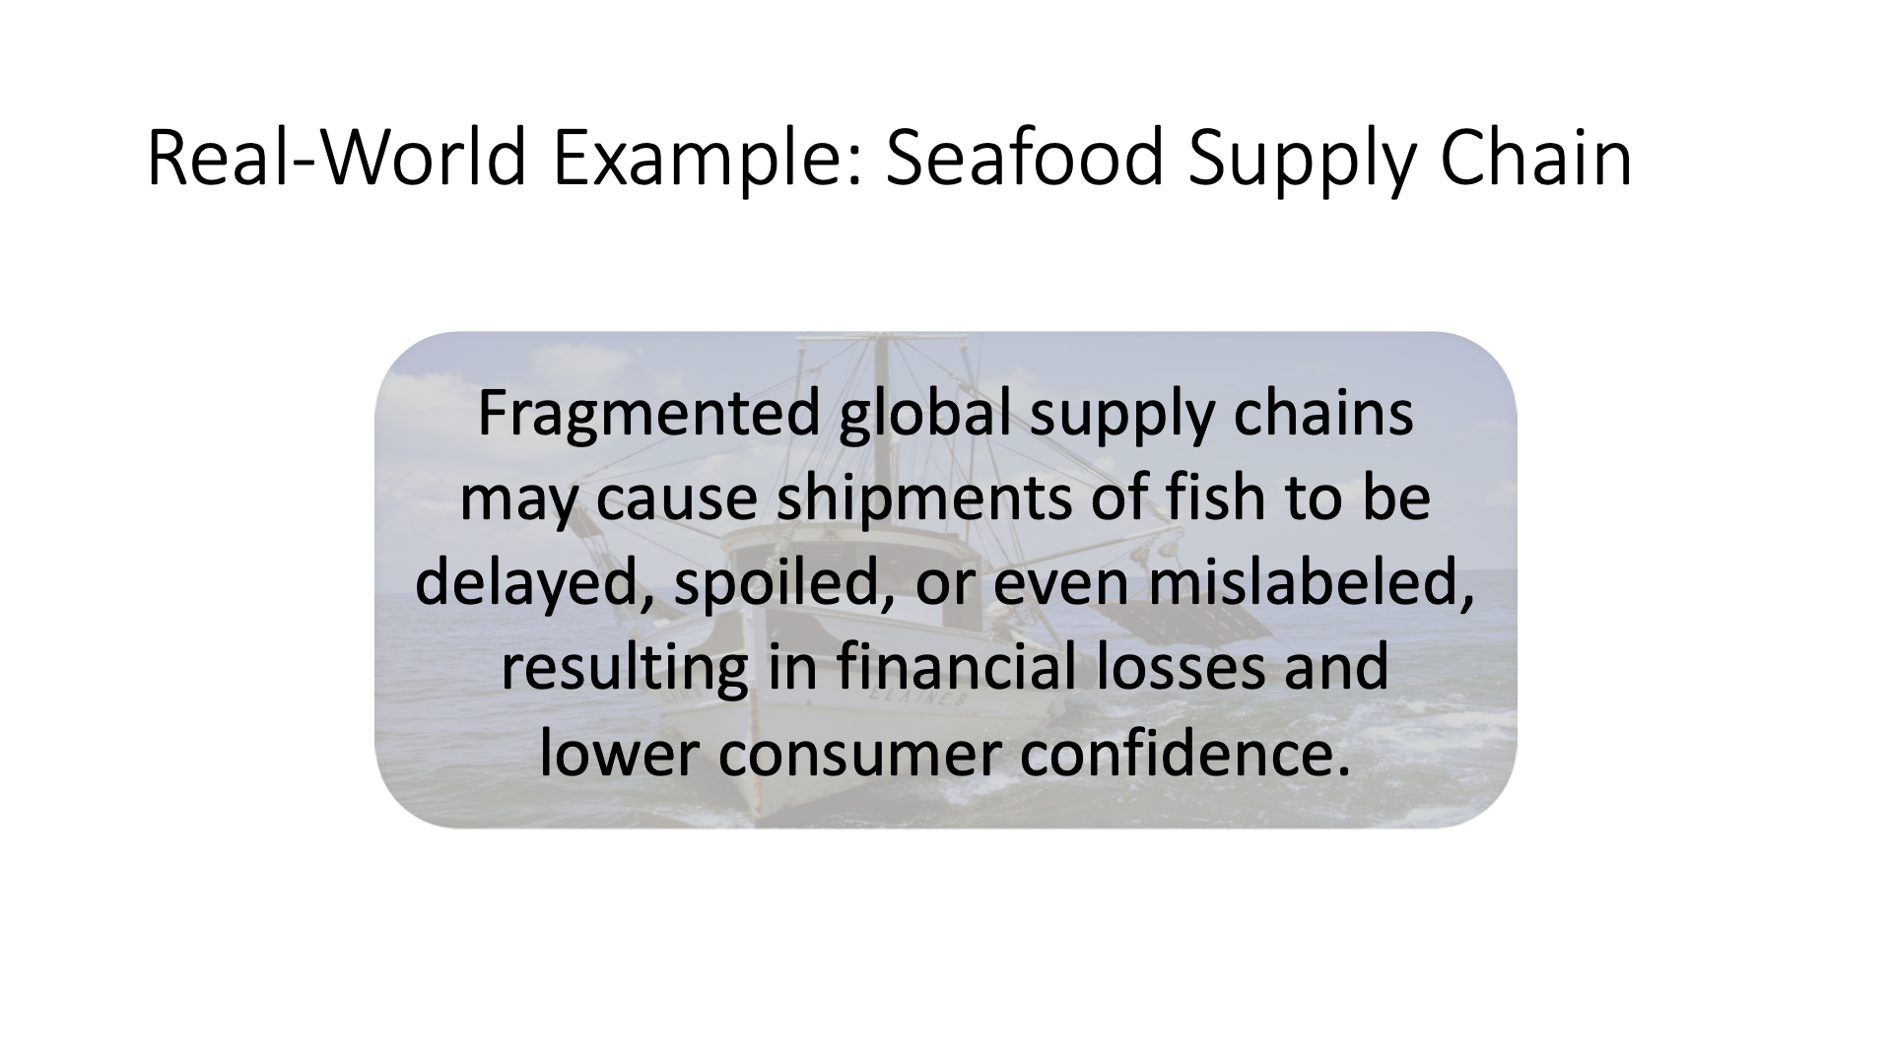

Slide 5
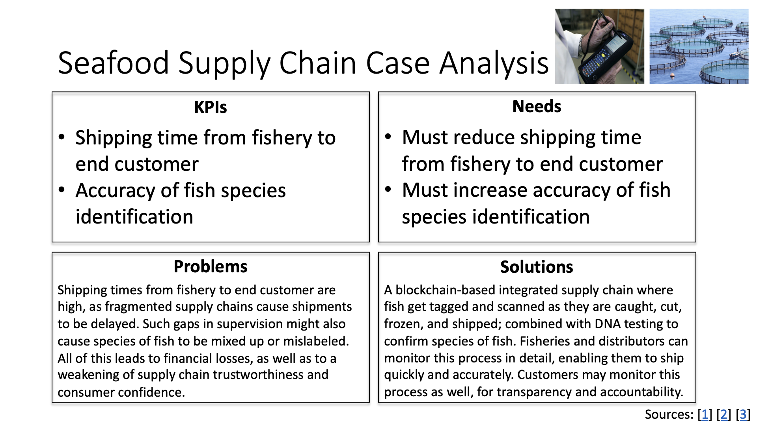

Slide 6
Define the Problem
If you don’t know what the problem is, how do you know you can solve it?
Defining the problem allows the group to set boundaries of what the problem is and what it is not and to begin to formalize a description or definition of the scope, size, or extent of the challenge the group will address.

Slide 7
Example Case Study
In the following example, we have a Web-based company called “Favorites” that needs to increase its customer base and sales. A problem-solving group has been formed, and they start by formulating a working definition of the problem.

Slide 8
Define the problem: example
Too broad: “Sales are off, our numbers are down, and we need more customers.”
More precise: “Sales have been slipping incrementally for six of the past nine months and are significantly lower than a seasonally adjusted comparison to 2021. Overall, this loss represents a 4.5 percent reduction in sales from the same time last year. However, when we break it down by product category, sales of our non-edible products have seen a steady increase (variable, but averaged to 8% increase in sales in 2022), while sales of edibles account for the drop off and we need to halt the decline.”

Slide 9
Analyze the Problem
Now the group analyzes the problem, trying to gather information and learn more. The problem is complex and requires more than one area of expertise.
Why do non-edible products continue selling well? What is it about the edibles that is turning customers off?

Slide 10
Example Analysis from an Employee
Looking at edibles and non-edibles, they will study the cycle of customer service and see if there are any common points—from the main Web page, through the catalog, to the purchase process, and to returns—at which customers abandon the sale.
Existing customer feedback loops with end-of-sale surveys could be used.

Slide 11
Establish Criteria
At this point, information is coming in from diverse perspectives, and each group member has contributed information from their perspective, even though there may be several points of overlap.

Slide 12
Criteria Example
Customers who complete the post-sale survey indicate that they want to know:
what is the estimated time of delivery (42% of respondents)
why a specific item was not in stock and when it will be available (30% of respondents)
why their order sometimes arrives with less than a complete order, with some items backordered (28% of respondents)
Only 7% percentage of customers complete the post-sale survey.

Slide 13
Consider Possible Solutions
Kevin: Is it possible for our programmers to create a cross-index feature, linking the product desired with a report of how many are in stock? I’d like the customer to know right away whether it is in stock, or how long they may have to wait.
As another idea, is it possible to add incentives to the purchase cycle that won’t negatively impact our overall profit? I’m thinking a small volume discount on multiple items, or perhaps free shipping over $80.
Lee: I recommend we hold a focus group where customers can sample our edible products and tell us what they like best and why. When the best sellers are sold out, could we offer a discount on related products to provide an instant alternative? We might also cut the underperforming products with a sale to generate interest.

Slide 14
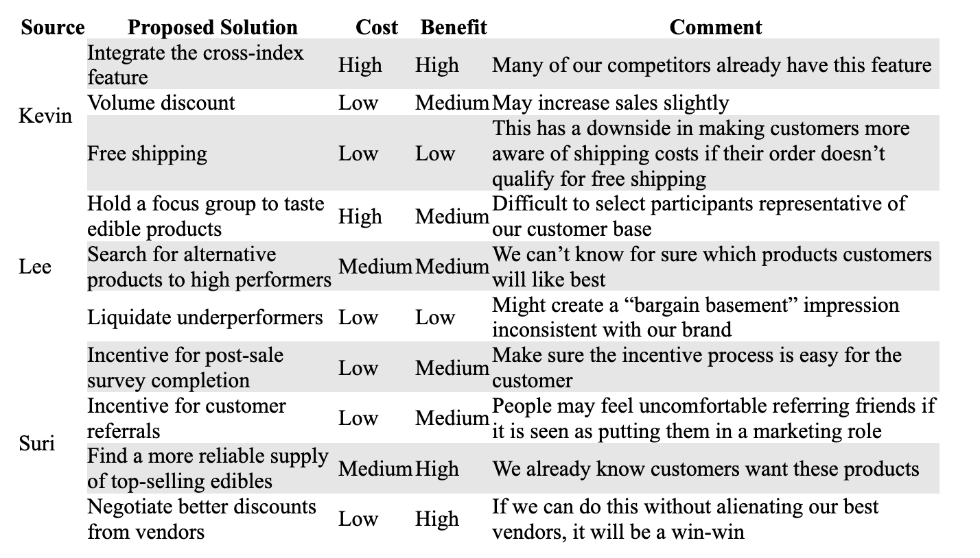
Decide on a Solution Using a Cost-Benefit Analysis

Slide 15
Implement the solution and follow up the solution
Kevin: After several tests, the cross-index feature was implemented and has been in place for thirty days. Now customers see either “in stock” or “available [mo/da/yr]” in the shopping basket. As expected, Kevin notes a decrease in the number of chat and phone inquiries to the effect of, “Will this item arrive before my wife’s birthday?” However, he notes an increase in inquiries asking, “Why isn’t this item in stock?” It is difficult to estimate customer satisfaction.
Lee: In exploring the merchandise available from competing merchants, she got several ideas for modifying Favorites’ product line to offer more flavors and other variations on popular edibles. Working with vendors, she found that these modifications cost very little. Within the first thirty days of adding these items to the product line, sales are up.

Slide 16
PNS Reflection
This scenario allows us to see that the problem may have several dimensions as well as solutions, but resources can be limited and not every solution is successful.
Even though the problem is not immediately resolved, the group problem-solving pattern serves as a useful guide through the problem-solving process.

Slide 17
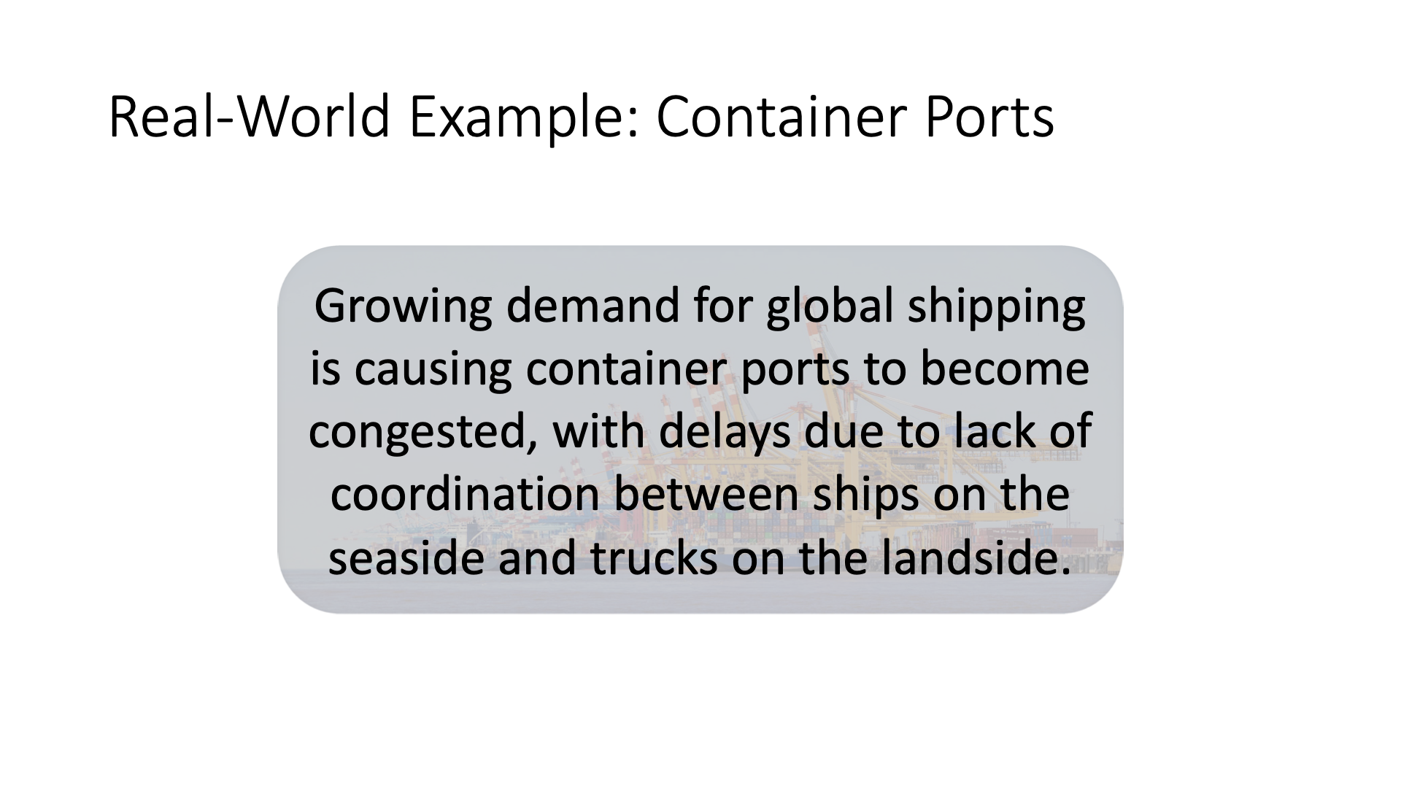

Slide 18
